Slide 1

Conflict Assessment: City of Gainesville straw ban
By: Melissa Moreno

Slide 2
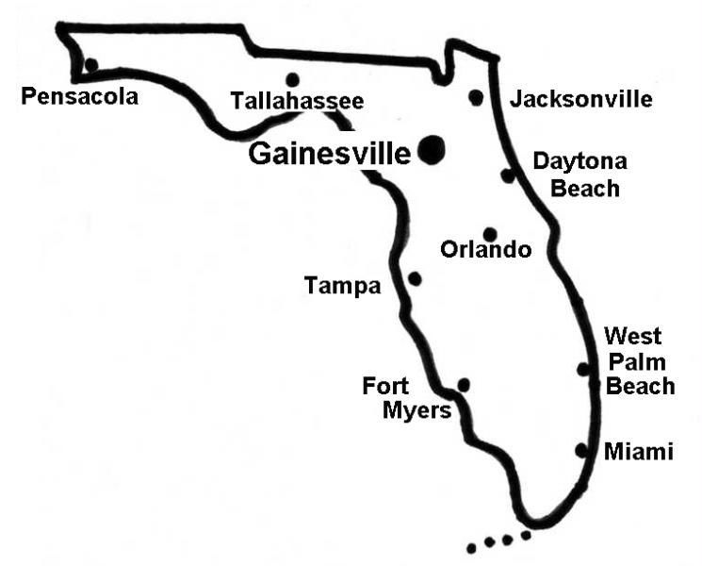
Case selection
For my case selection my focus will be on how the City of Gainesville is reacting to the single- use plastic straw ban, ban. Restaurants in Gainesville can elect to not present a straw with every drink, but there is no mandate or enforcement for all restaurants to follow this. As the University of Florida supports the research of many biologists and conservationists, it is safe to say that there is a strong population of residents that are interested in having the straw ban enforced. My research on this case will interview city officials and residents of Gainesville to record their viewpoints and their opinions on the straw ban. From these interviews I will have a clear understanding of how this ban is affecting the residents and local government.
Figure 1- Map of Florida, with an emphasis of Gainesville. (http://www.gainesvillefloridahomes.com/)

Slide 3
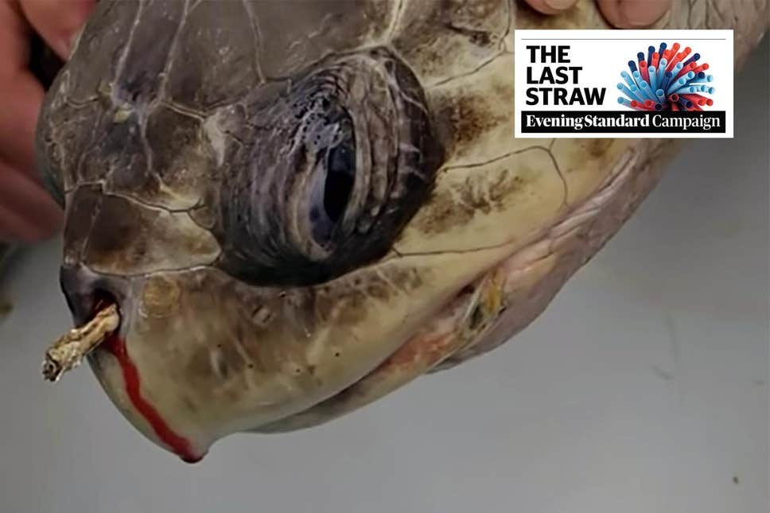
Introduction
On May 10, 2019 Governor Ron DeSantis used his veto power, for the first time since his appointment, declining to sign an environmental bill that would have prohibited local governments from banning plastic straws for the next five years.
Due to Governor Ron DeSantis using his veto power, local governments can now make their own decisions about the matter.
Even though the plastic straw ban has not been formally added as a policy, there have been many restaurants that have started to practice a single- use straw ban policy in Gainesville, Florida.
The City of Gainesville officials are continually pushing back the single-use plastic straw ban official meeting.
Figure 2- Image of turtle with straw in its nose video that went viral on YouTube and Facebook.

Slide 4
Stakeholder Analysis
Primary Stakeholders
A. State of Florida
Position: Because of the veto, the State of Florida wants the cities and counties to provide evidence, to support a single-use plastic straw ban, when the local government is applying to regulate the ban to the state government.
Interest: The State of Florida wanted this new bill to happen so that they can have the ultimate decision on whether a city or county can enforce a plastic straw ban would rely on the city or county and not the state.
Values: Now Florida believes that cities and counties should have the power to make their own single-use plastic straw ban bill.
Primary Stakeholders
B. City of Gainesville
Position: The City of Gainesville is currently voting on their position. It is not certain, at this present time, if the city will be in support or not of the plastic straw ban.
Interest: The reason why the City of Gainesville is voting on enforcing a straw ban is because it is a very hot topic. Residents of Gainesville are adamant and passionate about this ban and have voiced their concerns to the City of Gainesville government, so the city feels like they must take action on this subject.
Values: This value is not yet determined. Voting still in process.

Slide 5
Stakeholder Analysis pt.2
Primary Stakeholders
C. Residents of Gainesville opposed to the straw ban
Position: Many disabled people and elderly people do not want this straw ban to be enforced and for the City of Gainesville to vote no on the straw ban.
Interest: They do not want the straw ban to be enforced because they feel that their rights are being infringed upon and do not want to go through a hassle in looking for a readily available straw. They also believe that a strong plastic straw ban will mean straws will not be guaranteed in every restaurant. Restaurants not having straws readily available will impact this stakeholder group directly, specifically their mobility to consume beverages and comfort while dining out. Local restaurant owners are not interested because some might not be willing to change suppliers or add additional costs by choosing to purchase in bulk a more expensive straw type.
Values: Believes that every resident should have the right to a plastic straw if they required it. This group believes that a straw ban bill should not be passed because it infringes on the rights of some minority groups. This group believes in the equality of all people’s group.
Secondary Stakeholders
D. Residents of Gainesville for the straw ban
Position: Gainesville, Florida has a large population of conservationists. There are many state parks in Alachua County, which is the county of Gainesville, and the interest is there with many residents who are concerned about single-use plastic pollution.
Interest: The reason why the residents of Gainesville are passionate about the straw ban is because they are interested in protecting marine species, water ways, and overall be a more consciousness city. Whether or not the straw ban is enforced will not impact these residents directly, however.
Values: The values of this group are for the protecting and conservation of the environment for its intrinsic value. This group believes that the protection of the environment is above the rights of groups of people (i.e elderly and disabled).

Slide 6
Stakeholder | Environment | Individual Rights | Tourism | Business
State of Florida (responses from interviewed not yet received) | 3-4 | 3-4 | 5X | 5X
City of Gainesville (responses from interviewed not yet received) | 2-3 | 2-3 | 3-4 | 5X
Residents for the straw ban | 4X | 2 | 2 | 3
Residents against the straw ban | 3 | 4X | 2 | 4X
Table 1- Areas of agreement and disagreement matrix. 1 to 5 represent the level of priority, where 1 is the lowest and 5 is the highest.

Slide 7
Summary of interviews
GAINESVILLE RESIDENT FOR THE STRAW BAN
GAINESVILLE RESIDENT AGAINST THE STRAW BAN
This resident of Gainesville is aware of the environmental need for a single-use plastic straw ban, but they feel that there is not enough media coverage of the issue. I believe that the resident believes that the media is not doing a good job representing this conflict over the radio on NPR. They also believe that they could attend meetings and write letters to get conflict some more advertisement.
This resident feels that the single-use plastic straw ban is a “feel good initiative” because Gainesville is not near the coast, and the straw pollution will never reach the ocean. The resident believes that the turtle video with the straw in its nose (https://www.youtube.com/watch?v=4wH878t78bw) is one of the video that is causing the uproar to ban plastic straws. The resident also believes that the straw ban will come at a big expanse for the local restaurants and ultimately the price will come down to the consumers, so it might not be worth it to enact the straw ban.

Slide 8

Recommendations and conclusion
I would also recommend that the Residents of Gainesville send letters to the City of Gainesville to address their concerns to have the meeting be formally scheduled. Once the City of Gainesville sticks to their schedule to have the single-use plastic straw ban meeting, and seriously discuss the issue, they should be able to come to a final vote.
My conclusion is that there is still a lot of work needed to be done to resolve this issue and leave the stakeholders feeling satisfied or at least heard. The City of Gainesville needs to schedule a meeting to resolve this issue before the Residents of Gainesville start to become very impatient to get a resolution.
Figure 3- Example of single-use plastic straw ban marketing.

Slide 9
REFERENCES
Plastic Straws Are Out: Ron Desantis Vetoes Prohibition Of Local Straw Bans,
Samantha Gross - https://www.tampabay.com/florida-politics/buzz/2019/05/10/plastic-straw-are-out-ron-desantis-vetoes-prohibition-of-local-bans/ , May 10, 2019
Senate Panel Approves 5-year Delay on Plastic Straw Bans
Ryan Nicol - https://floridapolitics.com/archives/289919-senate-panel-plastic-straw-ban, March 4, 2019
Beck, Cathy A. and Nélio B. Barros. "The impact of debris on the Florida manatee." Marine Pollution Bulletin (1991).
Derraik, José G B. "The pollution of the marine environment by plastic debris: a review." Marine pollution bulletin (2002).
Schnurr, Riley E.J., et al. "Reducing marine pollution from single-use plastics (SUPs): A review." Marine Pollution Bulletin (2018).
Ye, Song and Anthony L. Andrady. "Fouling of floating plastic debris under Biscayne Bay exposure conditions." Marine Pollution Bulletin (1991).
Gainesville Commission plans to oppose the bill, Karina Eldwood, https://www.alligator.org/news/a-new-bill-might-ban-city-straw-bans/article_d77df52a-43b1-11e9-aecb-476dae2909e7.html, March 10, 2019

